Slide 1
Routing Table
CCNA Exploration Semester 2
Chapter 8
S Ward Abingdon and Witney College
Notes:
Routing Table
S Ward Abingdon and Witney College

Slide 2
Topics
The routing table
Types of route
Route lookup
Routing behaviour in routed networks
S Ward Abingdon and Witney College

Slide 3
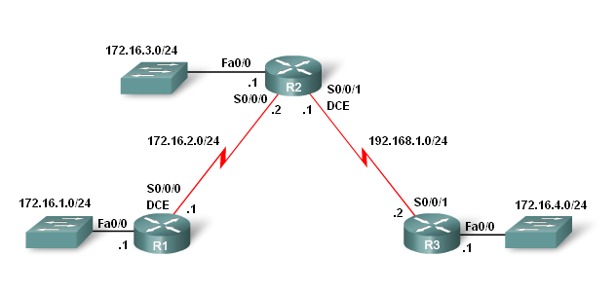
Topology Example

Slide 4
Routing Table Structure
Lab Topology
3 router setup
  -R1 and R2 share a common 172.16.0.0/16 network with 172.16.0.0/24 subnets.
  -R2 and R3 are connected by the 192.168.1.0/24 network.
  -R3 also has a 172.16.4.0/24 subnet, which is disconnected, or discontiguous, from the 172.16.0.0 network that R1 and R2 share.

Slide 5

Adding a connected route
Configure IP address on interface
Give no shutdown command
Directly connected route is put in routing table at once.
Use debug ip routing to see this.
S Ward Abingdon and Witney College

Slide 6
Level 1 routes
A route with a subnet mask equal to or less than the classful mask.
  192.168.1.0/24 is a level 1 network route. /24 is the classful mask.
  192.168.128.0/20 is a level 1 supernet route. Less than classful mask.
  0.0.0.0/0 Default route
Can be directly connected, static or dynamic
S Ward Abingdon and Witney College

Slide 7
Ultimate Route
An ultimate route is a route that includes:
  either a next-hop IP address (another path)
  and/or an exit interface
C 192.168.1.0/24 is directly connected, Serial0/0/1
S Ward Abingdon and Witney College

Slide 8

Parent and child
Level 2
Child route
Subnet of classful network
Level 1
Parent route
Added when child route is added
No exit information
S Ward Abingdon and Witney College

Slide 9
Parent and child
Parent route shows subnet mask used by child route(s).
This is shown when all subnets have the same mask.
S Ward Abingdon and Witney College

Slide 10

VLSM used (classless)
Parent route shown with default mask, variably subnetted, number of subnets and masks used.
Each child route shown with its own mask.
S Ward Abingdon and Witney College

Slide 11
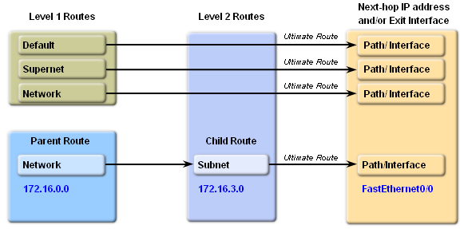
Hierarchy
S Ward Abingdon and Witney College

Slide 12
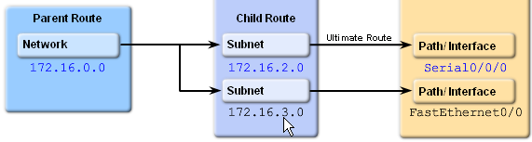
More than one child route
Parent route can have several child routes.
Parent route is added with first child route.
Parent is deleted if all child routes are deleted.
S Ward Abingdon and Witney College

Slide 13
Route lookup step 1
Packet addressed to 192.168.3.4
172.16.0.0/16 is variably subnetted, 3 subnets, 2 masks
C 172.16.1.4/30 is directly connected, Serial0/0
C 172.16.1.8/30 is directly connected, Serial0/1
C 172.16.1.0/24 is directly connected, FastEthernet0/0
C 192.168.3.0/24 is directly connected, FastEthernet0/1
S* 0.0.0.0/0 is directly connected, Serial0/0
Examine level 1 routes for best match
Finds match with 192.168.3.0/24
Ultimate route – forward packet
S Ward Abingdon and Witney College

Slide 14
Route lookup step 1
Packet addressed to 172.16.1.6
172.16.0.0/16 is variably subnetted, 3 subnets, 2 masks
C 172.16.1.4/30 is directly connected, Serial0/0
C 172.16.1.8/30 is directly connected, Serial0/1
C 172.16.1.0/24 is directly connected, FastEthernet0/0
C 192.168.3.0/24 is directly connected, FastEthernet0/1
S* 0.0.0.0/0 is directly connected, Serial0/0
Examine level 1 routes for best match
Finds match with 172.16.0.0/16 (parent)
Examine child routes of this parent
S Ward Abingdon and Witney College

Slide 15
Route lookup step 2
Packet addressed to 172.16.1.6
172.16.0.0/16 is variably subnetted, 3 subnets, 2 masks
C 172.16.1.4/30 is directly connected, Serial0/0
C 172.16.1.8/30 is directly connected, Serial0/1
C 172.16.1.0/24 is directly connected, FastEthernet0/0
C 192.168.3.0/24 is directly connected, FastEthernet0/1
S* 0.0.0.0/0 is directly connected, Serial0/0
Examine child routes of 172.16.0.0
Match with 172.16.1.0/24
Ultimate route – forward packet
S Ward Abingdon and Witney College

Slide 16
Route lookup step 1
Packet addressed to 172.16.2.8
172.16.0.0/16 is variably subnetted, 3 subnets, 2 masks
C 172.16.1.4/30 is directly connected, Serial0/0
C 172.16.1.8/30 is directly connected, Serial0/1
C 172.16.1.0/24 is directly connected, FastEthernet0/0
C 192.168.3.0/24 is directly connected, FastEthernet0/1
S* 0.0.0.0/0 is directly connected, Serial0/0
Examine level 1 routes for best match
Finds best match with 172.16.0.0/16 (parent)
Examine child routes of this parent
S Ward Abingdon and Witney College

Slide 17
Route lookup step 2
Packet addressed to 172.16.2.8
172.16.0.0/16 is variably subnetted, 3 subnets, 2 masks
C 172.16.1.4/30 is directly connected, Serial0/0
C 172.16.1.8/30 is directly connected, Serial0/1
C 172.16.1.0/24 is directly connected, FastEthernet0/0
C 192.168.3.0/24 is directly connected, FastEthernet0/1
S* 0.0.0.0/0 is directly connected, Serial0/0
Examine child routes of 172.16.0.0
None of the child routes matches
Are we doing classful or classless routing?
S Ward Abingdon and Witney College

Slide 18
Route lookup step 3
Packet addressed to 172.16.2.8
172.16.0.0/16 is variably subnetted, 3 subnets, 2 masks
C 172.16.1.4/30 is directly connected, Serial0/0
C 172.16.1.8/30 is directly connected, Serial0/1
C 172.16.1.0/24 is directly connected, FastEthernet0/0
C 192.168.3.0/24 is directly connected, FastEthernet0/1
S* 0.0.0.0/0 is directly connected, Serial0/0
Classful routing
That’s it – drop the packet
S Ward Abingdon and Witney College

Slide 19
Route lookup step 4
Packet addressed to 172.16.2.8
172.16.0.0/16 is variably subnetted, 3 subnets, 2 masks
C 172.16.1.4/30 is directly connected, Serial0/0
C 172.16.1.8/30 is directly connected, Serial0/1
C 172.16.1.0/24 is directly connected, FastEthernet0/0
C 192.168.3.0/24 is directly connected, FastEthernet0/1
S* 0.0.0.0/0 is directly connected, Serial0/0
Classless routing
Check level 1 routes for any other match
Find match with default route and use that
S Ward Abingdon and Witney College

Slide 20
Best (longest) match
IP Packet
Destination
172.16.0.10
10100011.00010000.00000000.00001010
Route 1
172.16.0.0/12
10100011.00010000.00000000.00000000
Match 12 bits?
Yes
S Ward Abingdon and Witney College

Slide 21
Best (longest) match
IP Packet
Destination
172.16.0.10
10100011.00010000.00000000.00001010
Route 1
172.16.0.0/12
10100011.00010000.00000000.00000000
Route 2
172.16.0.0/18
10100011.00010000.00000000.00000000
Match 18 bits?
Yes - better
S Ward Abingdon and Witney College

Slide 22
Best (longest) match
IP Packet
Destination
172.16.0.10
10100011.00010000.00000000.00001010
Route 1
172.16.0.0/12
10100011.00010000.00000000.00000000
Route 2
172.16.0.0/18
10100011.00010000.00000000.00000000
Route 3
172.16.0.0/26
10100011.00010000.00000000.00000000
Match 26 bits? Yes – better still
S Ward Abingdon and Witney College

Slide 23
No match
IP Packet
Destination
172.16.0.10
10100011.00010000.00000000.00001010
Route 4
172.17.0.0/16
10100011.00010001.00000000.00000000
Need to match 16 bits.
No. Only the first 15 bits match so no good.
S Ward Abingdon and Witney College

Slide 24
Default route match
IP Packet
Destination
172.16.0.10
10100011.00010000.00000000.00001010
Default Route
0.0.0.0/0
00000000.00000000.00000000.00000000
0 bits need to match.
Anything can match with the default route but it will always be the least good match
S Ward Abingdon and Witney College

Slide 25
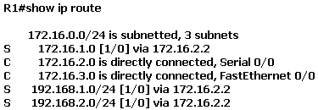
Recursive lookup reminder
Find a route to 172.16.1.0/24
There it is, via 172.16.2.2
How do you get to 172.16.2.2?
There it is via serial 0/0.
S Ward Abingdon and Witney College

Slide 26
Routing source
Routing sources
Directly connected networks
Static routes
Classful routing protocols
RIPv1, IGRP
Classless routing protocols
RIPv2, EIGRP, OSPF, IS-IS
Build up routing table
Can use several sources
S Ward Abingdon and Witney College

Slide 27
Routing behaviour
Routing behaviours
No IP classless
Classful behaviour
IP classless
Classless behaviour
Searching routing table
Can only use one
Default since IOS version 11.3
S Ward Abingdon and Witney College

Slide 28
A puzzle
A router has a default route but it still drops packets.
Possible solution: the router is using classful routing behaviour. It will drop packets addressed to subnets that are not in its routing table if the parent network is in the routing table.
Change to classless routing behaviour
S Ward Abingdon and Witney College

Slide 29
The End
S Ward Abingdon and Witney College

